Slide 1
shadcn/ui
Nir Tamir

Slide 2
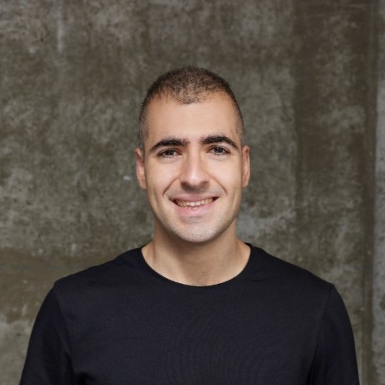
Nir Tamir
Senior Frontend developer
Works at Youleap
Loves open source and tooling
https://nirtamir.com

Slide 3
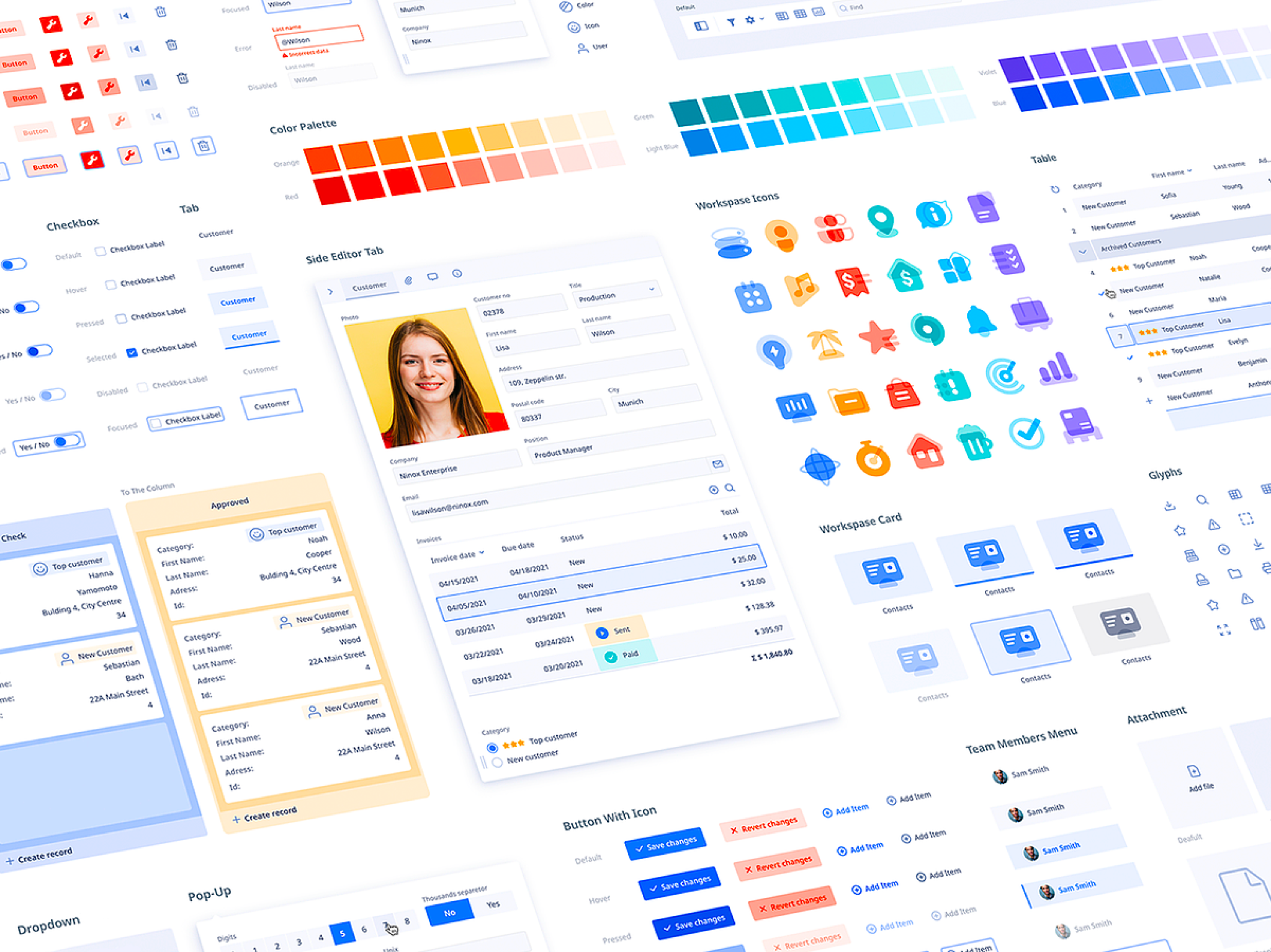

Slide 4
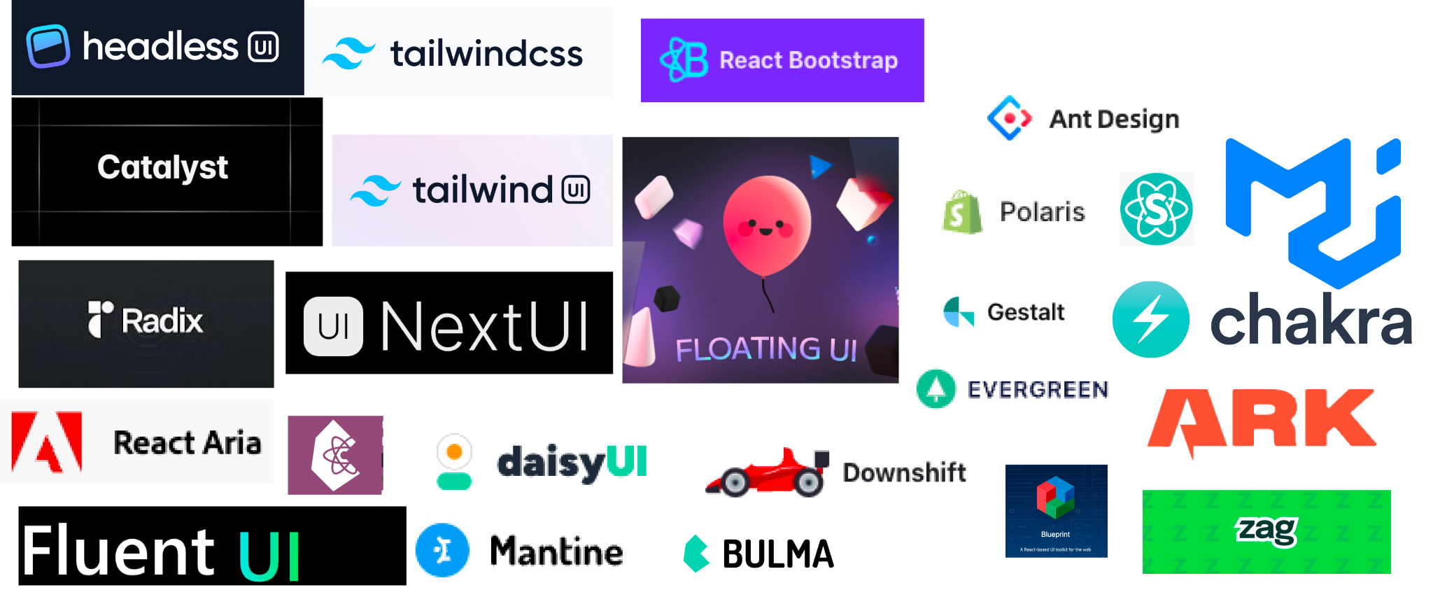

Slide 5
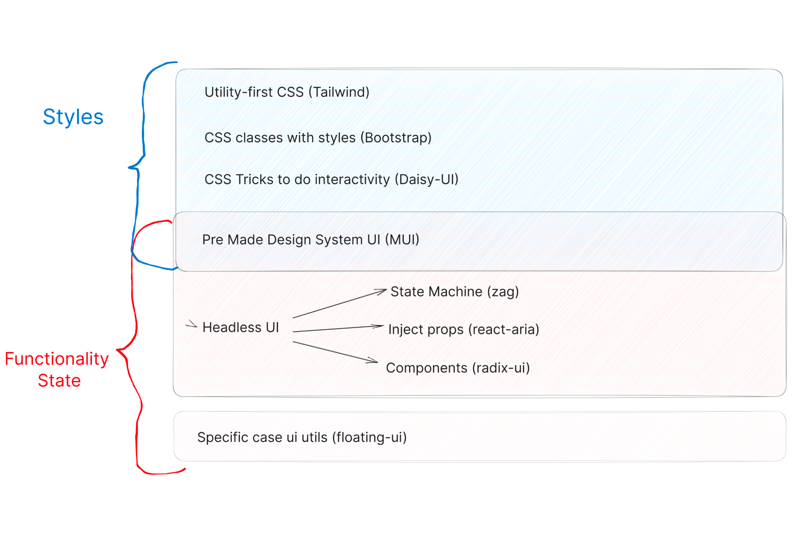

Slide 6
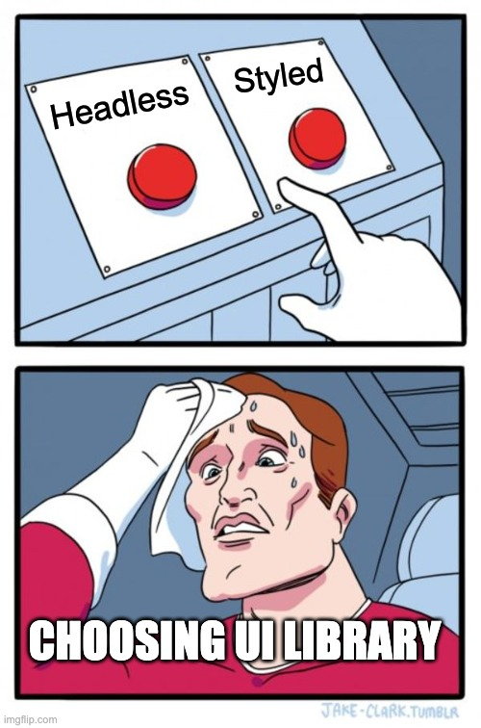

Slide 7
Styled UI
Looks good
But you lack a lot of control
mui

Slide 8
Headless UI
Accessibility (a11y)
Primitive
Control
But you need to style it yourself
radix-ui

Slide 9
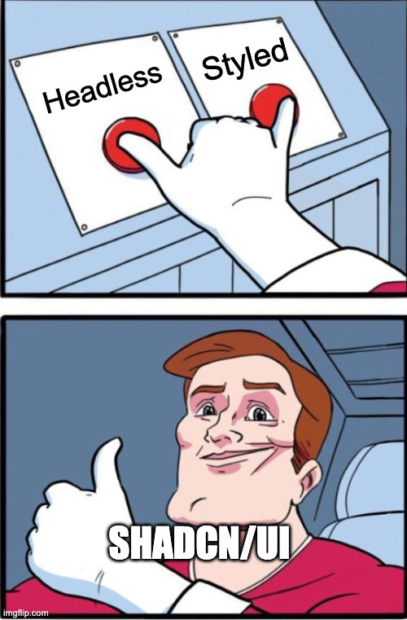

Slide 10
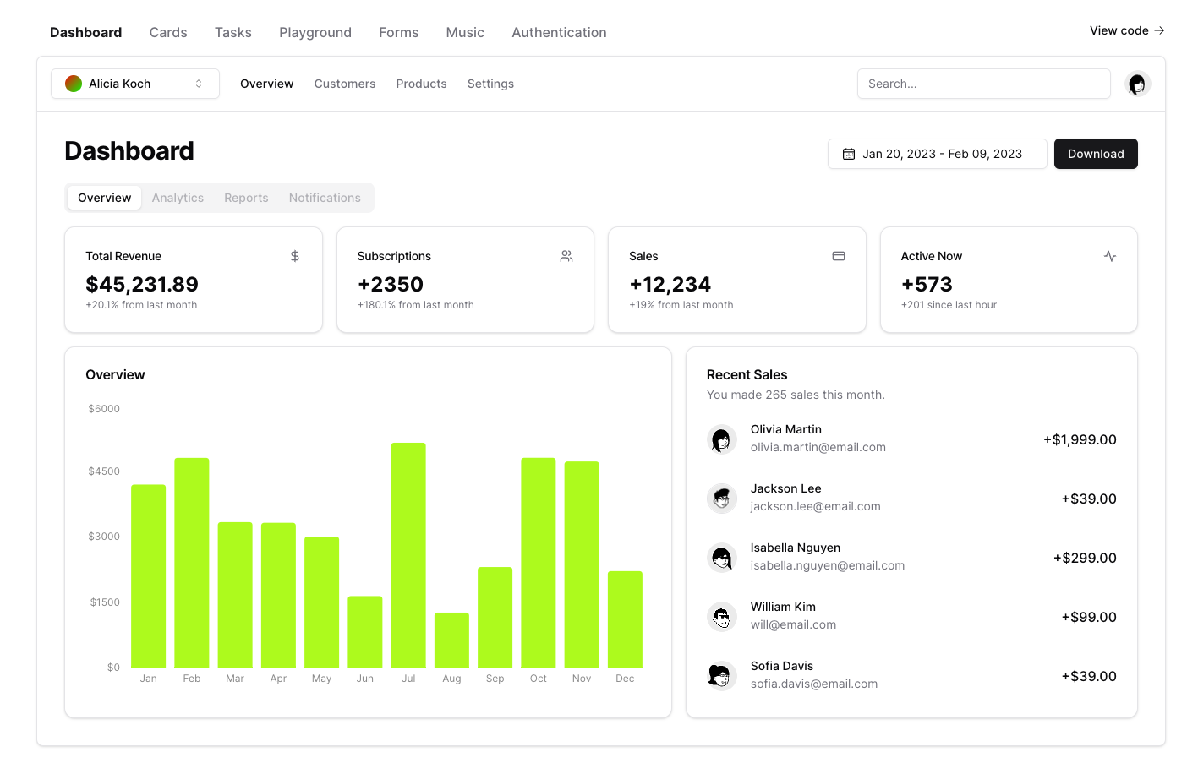
shadcn/ui

Slide 11
This is NOT a component library
It's a collection of re-usable components that you can copy and paste into your apps.

Slide 12
Lets build out App

Slide 13
Themes
Colors
Dark

Slide 14
Final App
Deployed URL
GitHub shadcn-meetup-demo

Slide 15
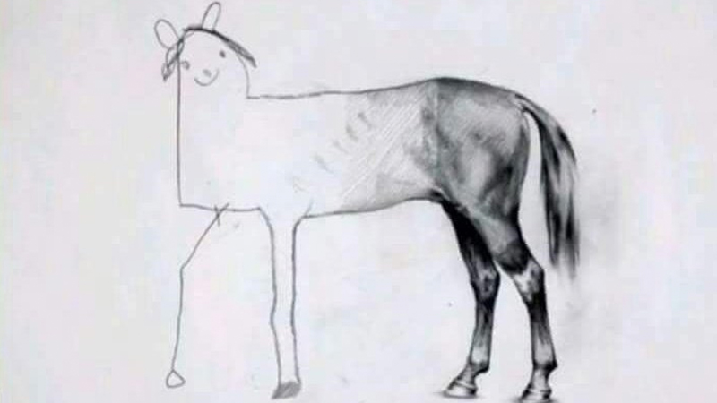

Slide 16
Not just react
shadcn-solid
shadcn-svelte
park-ui - ark-ui and pandacss

Slide 17
The Future
https://twitter.com/shadcn/status/1673690479349895169

Slide 18
Thanks
Nir Tamir
nirtamir.com

Slide 19




Thanks To Our Gold Sponsors:
And Our Silver Sponsors:
SUPPORT THE COMMUNITY:
SUBMIT YOUR LECTURE:
http://bit.ly/jsil-sponsor
http://bit.ly/jsil-cfp
meetup.com/javascript-israel
facebook.com/groups/jsisrael

